Slide 1
Simplifying Boolean Functions
F(x,y,z)=∑(0,2,3,4,5,7)
F(a,b,c,d)=∑(0,3,4,5,7,11,13,15)
F(w,x,y,z)=∑(0,1,4,5,9,11,13,15)
F(a,b,c,d)=∑(0,1,2,4,5,6,8,9,12,13,14)
F(a,b,c,d)=∑(1,3,4,5,7,8,9,11,15)
F(w,x,y,z)=∑(1,5,7,8,9,10,11,13,15)

Slide 2
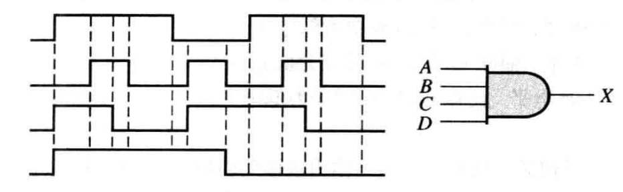
8.The input waveforms applied to 4-input AND gate are as
indicted in Figure 3-61. Show the output waveform in proper
relation to the inputs with a timing diagram.
x:

Slide 3
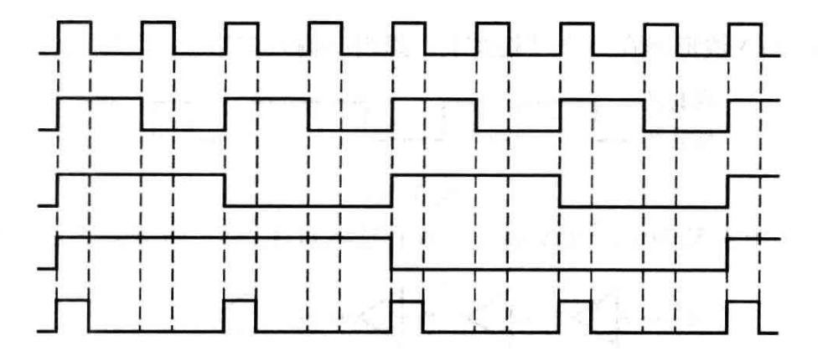
12(14).For the five input waveforms in Figure 3-62, determine
the output if the five signals are ANDed. Determine the output
if the five signals are ORed. Draw the timing diagram for each
case.

Slide 4
AND gate output:
OR gate output :

Slide 5
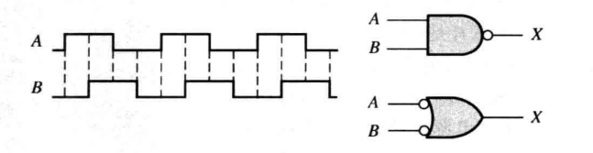
18(20).Using NAND and negative-OR these two functional
viewpoints, show that each gate will produce the same output
for the given inputs.

Slide 6
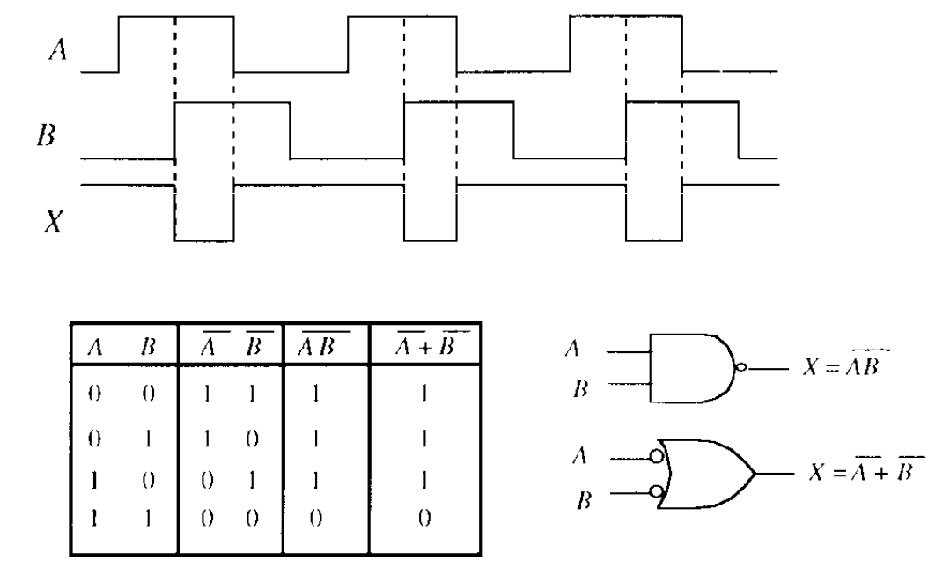

Slide 7
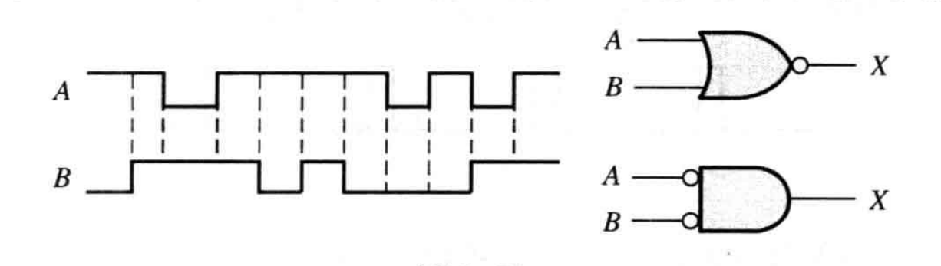
22(24). Using NOR and negative-AND these two functional
viewpoints, show that both gates in Figure 3-68 will produce
the same output for the given inputs.

Slide 8
